Slide 1


Gaminger Initiative
History and Evolution
Col CH HeidI KORNEK
1st Cap ITA ( R ) Giuseppe COLLOT

Slide 2
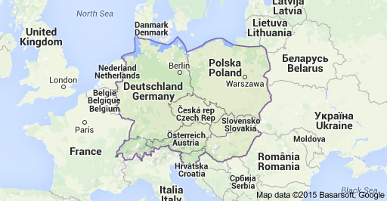
Gaminger Initiative
History and Evolution
“Gaminger Initiative" (GI) is an International Union of Officers and Reserve Officers Associations, as a carrier of the European Union Military Cooperation
GI is an non-governmental, independent, non-political, non-profit Organization
GI currently has 10 member countries: Austria, Croatia, Germany, Italy, Czech Republic, Poland, Slovakia, Slovenia, Hungary, Switzerland, which effectively cover the Central European area
www.unuci.org
www.sog.ch
www.reservistenverband.de
www.oeog.at
www.hczpgz.net
www.matasz.com
www.federez.pl
www.szvvz.sk
www.zsc.si
www.svazdap.cz

Slide 3
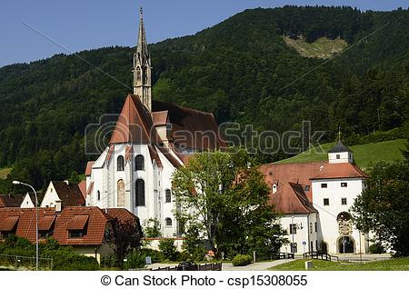


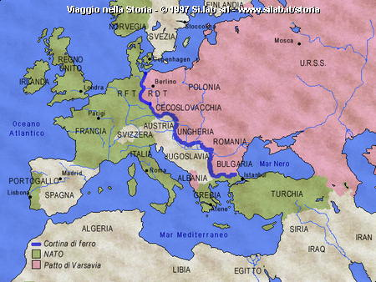
Gaminger Initiative
History and Evolution
GI was formally founded on May 28th, 1995 but its has ots origin in the “Gaming Talks” held since 1989 in Gaming, a charming small Austrian village
GI was founded on an idea by German General Arne Steinkamp Swiss Colonel Charles Ott, and Austrian Colonel Volker Zimmermann, shortly before the dissolution of the Warsaw Pact.
Their original Goal was to bring together the military and reserve officers Associations of Austria, Germany, Italy and Switzerland with those of the Central European Countries, which were formed after this significant political change d (the so called “Wende”)t
The conflict between the two Blocs, moreover, had strongly affected both the military theories and their structure of the Armed Forces of different Countries involved, who now had to move into new social, economic, military, institutional and international, unknown Scenarios ,

Slide 4
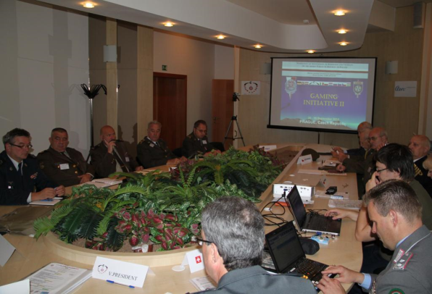
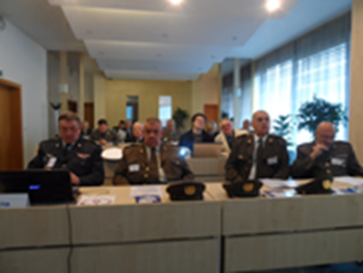
Gaminger Initiative
History and Evolution
In this context, more serene for Central Europe, were opened new windows of dialogue ( the Gaming Talks), which also led to consider a Military Integration Project, establishing a trustworthy base for mutual information and cooperation. which before the logic of the opposition made it impassable.
First actors of this Project were the military Units consist of Reservists:
    - Well integrated in the military, and social context
    - Open to dialogue
    - Less bound by political–military rigid rules and
    procedures
In this context, the Gaminger Talks were therefore a valuable tool of "Military Diplomacy", parallel to the long and complicated official discussions of Military Staff

Slide 5
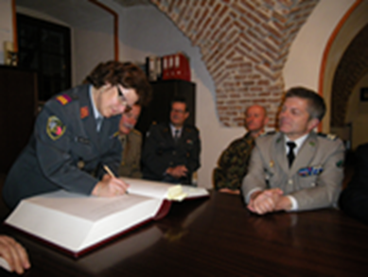
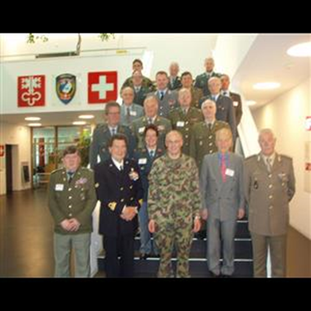
Gaminger Initiative
History and Evolution
They represented a useful instrument and contribution to the Project of Integration and Cooperation, as a body flexible, while official and unofficial, built by the Associations of Reservists are well integrated into their Community and recognized by their Ministries of Defense.
The Reservists were also a great tool to help Countries of the former Soviet Bloc in the process of "Democratization" and "Westernization" initiated, which subsequently led these Countries to join the EU and NATO.
The important and appreciated activities related to Gaminger Talks, it resulted in 1995 in the creation of the "Gaming Initiative" as a formal Association and its political and military unanimous recognition from the various constituent Countries and from International Institutions.

Slide 6


Gaminger Initiative
History and Evolution
In 2002, the GI has signed a Memorandum of Understanding with the CIOR - .”Confédération Interalliée des Officiers de Réserve”, welcoming Reserve Officers of NATO and that includes among its member countries even many of the Countries belonging to the GI.
Both Organizations, while working closely, however, remain independent and autonomous in their respective spheres of competence

Slide 7

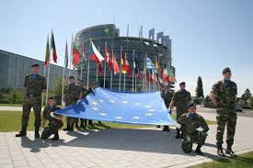
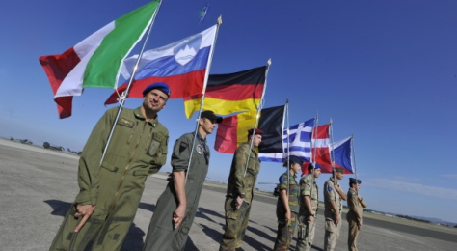
Gaminger Initiative
History and Evolution
In 2004, the Country Delegates of Gaminger Initiative decided in favor of a Reorientation Process if its Mission and Goals
The Gaminger Initiative is now focused on important issues of European Security Policy and Military Affairs.
It is a regional, Middle-European platform of their Officers- and Reservists Associations, which are accepted from policy and armed forces in their Countries
The Gaminger Initiative is at work on a level under policy and armed forces in the sense of national and European Defense Capability.
Main emphasis is the role of reservists in more and more professionalized armed forces and the role of armed forces in Europe.
The Gaminger Initiative makes a contribution, that the very reduced armed forces can hold the contact to the society and that the required specialists and reservists are educated well

Slide 8


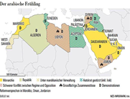
Gaminger Initiative
History and Evolution
At today, new Scenarios of relevance, such as terrorism, immigration, wars and revolutions taking place, closer and closer, they are again compromising the safety and the stability of our European Countries.
In this context, political and military Institutions must adapt quickly to this new reality, to find the best solutions.
As well as, Gaminger Initiative, having qualified and recognized skills and expertise and having over 25 years experience in the political, diplomatic and military context will have it to update its Mission quickly to the change.
With the aim of giving again a valuable contribution to ours civil Society and Communities

